Slide 1

Student Videos:
A Great Supplement
For Writing Assignments
Bill Bergman
Loyola U. Chicago
August 14, 2024

Slide 2
Benefits
Provides check on AI “shortcutting,” and reinforces learning.
Provides broader and deeper benefits for student development.
Helps personalize/motivate relationship with students.
First inspired by my own lecture videos experience.
  What’s good for the goose is good for the gander.

Slide 3
Video Snippets
Alina Chaudhary
Lydia Garcia
Noah Shaw

Slide 4
Observation 1
Question: “May I please share parts of your video with Loyola faculty?”
Answer: “Yes, of course. Thank you for asking! The videos really allowed me to understand and conceptualize the concepts of the course and without it I don’t think I would have the grade I currently have.”

Slide 5
Observation 2
“Thank you for a great learning experience this summer. I really enjoyed learning more about investments, and the reflection videos were a great way for us students to retain information by taking another step into the thought process of applying learning concepts!”

Slide 6
Observation 3
“Many of us in my generation seem to lack strong and confident public speaking skills, so I truly appreciate your idea of requiring us to create these videos. It may be uncomfortable initially, but if we truly develop and hone our ability to speak clearly, articulately, and confidently, we will be propelled forward 10-fold in life (professionally and personally).”

Slide 7
Observation 4
“Dr. Andrew Huberman (Professor at Stanford) recently spoke about how professors have been slowly reducing the difficulty of their teachings due to our reduced cognitive focus capacity and ability to learn complicated college-level materials, ultimately producing a lower outcome of human minds. Huberman asserts this reduction is attributed to the unregulated use of social media and how everything is at the tips of our hands, weakening our minds since we are not often prompted to engage in deep, contemplative thinking. In sum, thank you for challenging us with your public speaking exercises!”

Slide 8

Ten Lessons from Sailboat Racing for Finance and Investing

Slide 9
Lessons From Sailboat Racing for Finance
Be on time
Look ahead
Sail it flat
Sail your own race
Don’t follow the crowd
Tack on the headers
Know the rules
Stay out of the courtroom
Don’t tip over
If you do tip over, get it back up quickly

Slide 10

Be On Time

Slide 11

Look Ahead

Slide 12

Sail It Flat

Slide 13

Sail Your Own Race / Don’t Follow the Crowd

Slide 14
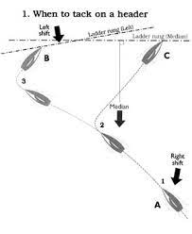
Tack on the Headers

Slide 15
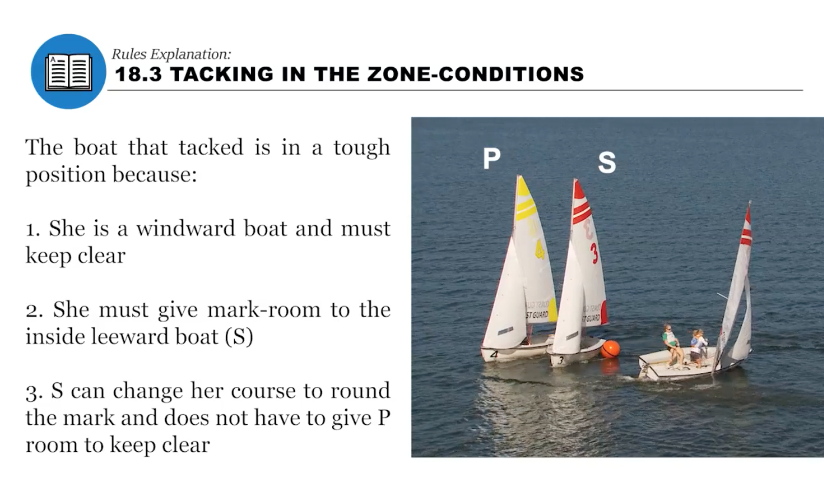
Know the Rules

Slide 16

Stay Out of the Courtroom

Slide 17

Don’t Tip Over

Slide 18
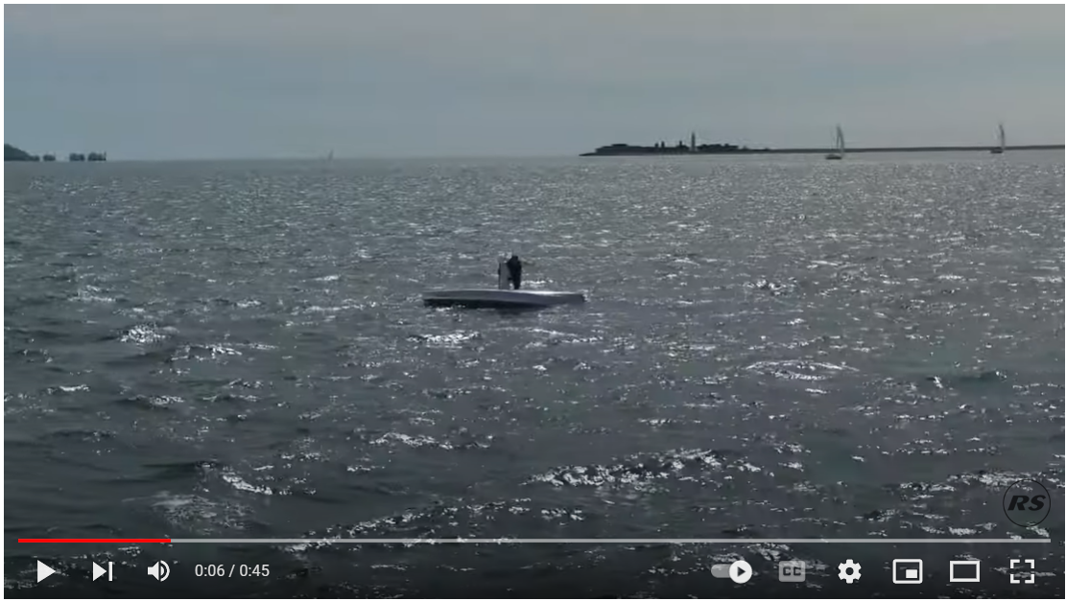
If You Do Tip Over, Get it Back Up Quickly

